Slide 1
Cardiovascular Disease Death Rates Analysys in the United States
By: Julia, Walgama, Meredith, Chelsea
Data Analytics & Data visualization boot camp – University of Minnesota ,Minnesota,USA

Slide 2
Background
CVD (Cardiovascular Disease) is the leading cause of death, per the Mayo Clinic. It's prevalent in both developed and developing nations. Risk factors for CVD encompass demographic, environmental, and physiological aspects, alongside potentially other significant factors.
Therefore, it's imperative to collect and analyze data on CVD-related deaths to inform decisions aimed at reducing mortality rates and risk factors.
Data Analytics & Data visualization boot camp – University of Minnesota ,Minnesota,USA

Slide 3
Scope of the Project
In this project, we are specifically analyzing counties within the United States of America (USA). Our further analysis will concentrate on demographic risk factors associated with CVD death rates.
We sourced the data for this analysis from catalog.data.gov.
For smoking rates, refer to: www.lung.org/research
Data Analytics & Data visualization boot camp – University of Minnesota ,Minnesota,USA
Notes:
[https://www.lung.org/research/trends-in-lung-disease/tobacco-trends-brief/rates-by-state#item-915365502]"

Slide 4
Areas of Analysis
The US at a glance
Breakdown of MN county death rate averages
Geographical distribution of CVD death rates
Correlation between CVD death and smoking
Breakdown of CVD death rates and gender
Breakdown of CVD in Ethnicity
Data Analytics & Data visualization boot camp – University of Minnesota ,Minnesota,USA

Slide 5
Cleaning the Data
We performed the following to clean our data set
Removed unnecessary columns
Removed duplicate columns
Narrowed the data set to Age-adjusted and Spatially smoothed 3-year Average Rate
Removed insufficient or incomplete rows.
Renamed columns
All the the above was completed to enhance the clarity of the data gathered.
Data Analytics & Data visualization boot camp – University of Minnesota ,Minnesota,USA

Slide 6
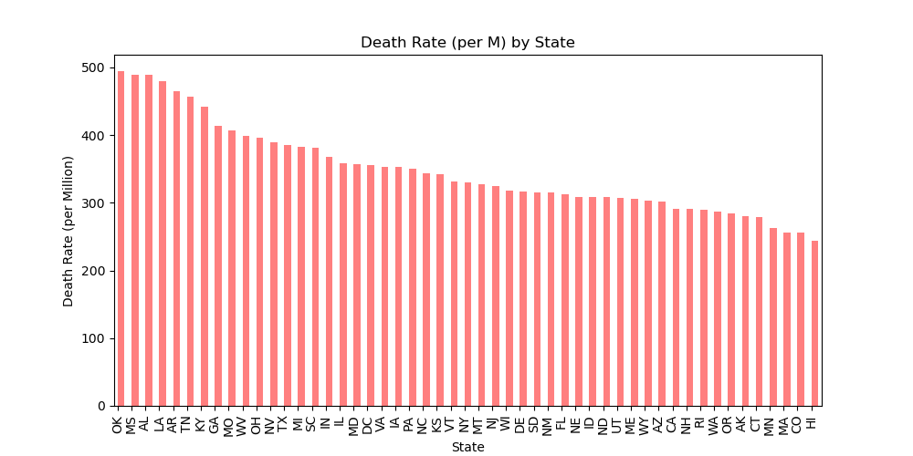
Country Breakdown by State
The country average death rate from CVD was 364 per Million, MN is below with an average is 262.
Data Analytics & Data visualization boot camp – University of Minnesota ,Minnesota,USA

Slide 7
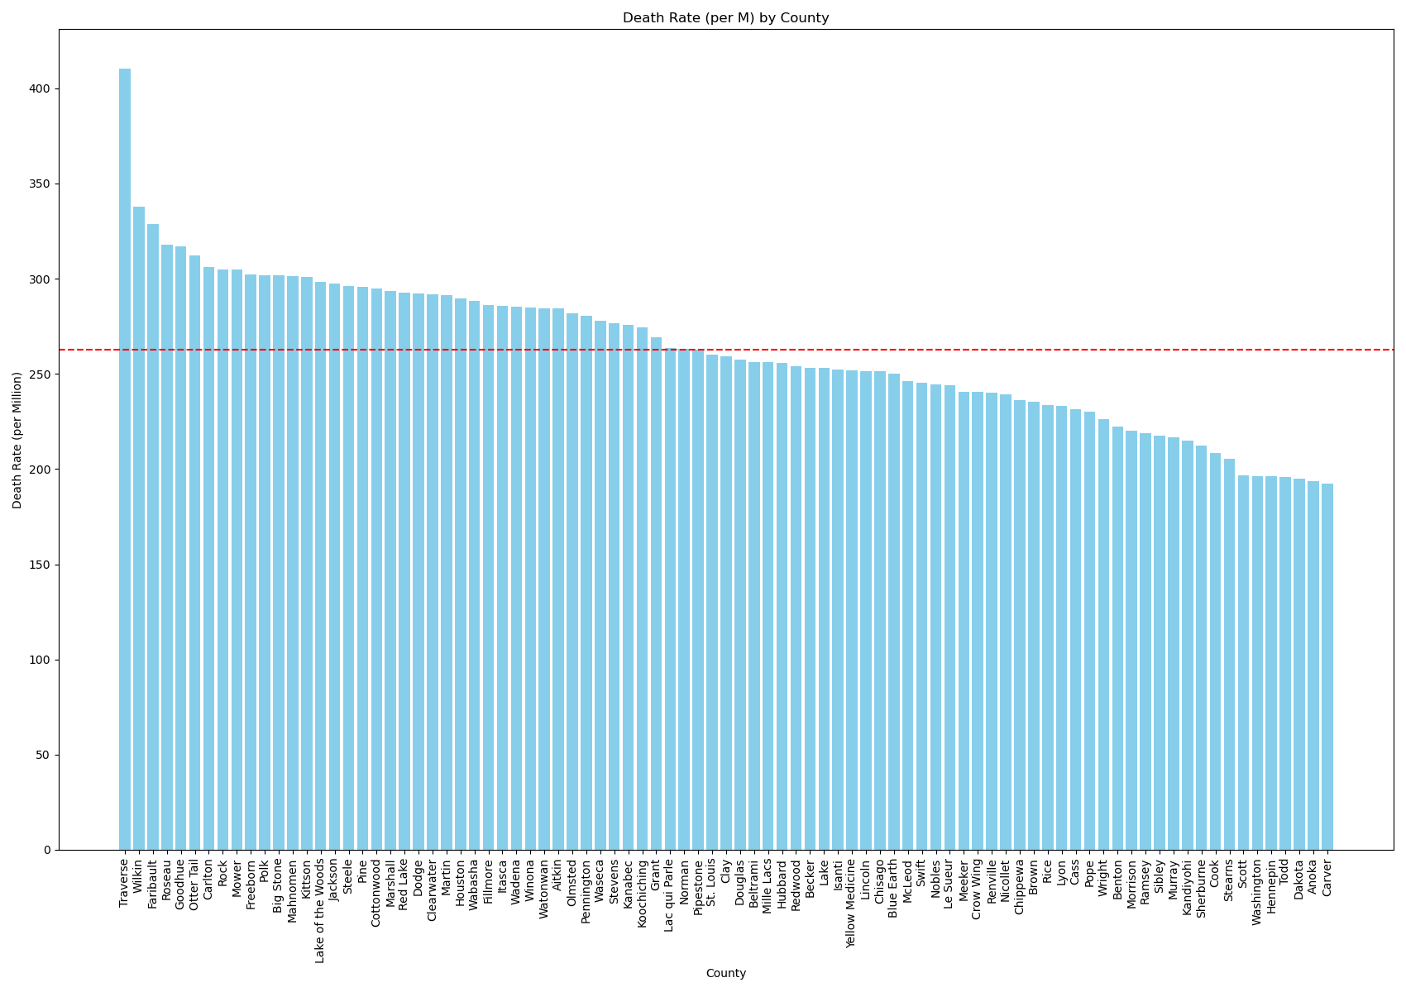
States Breakdown
The red dotted line indicates the average death rate per million in the state of MN.
Data Analytics & Data visualization boot camp – University of Minnesota ,Minnesota,USA

Slide 8
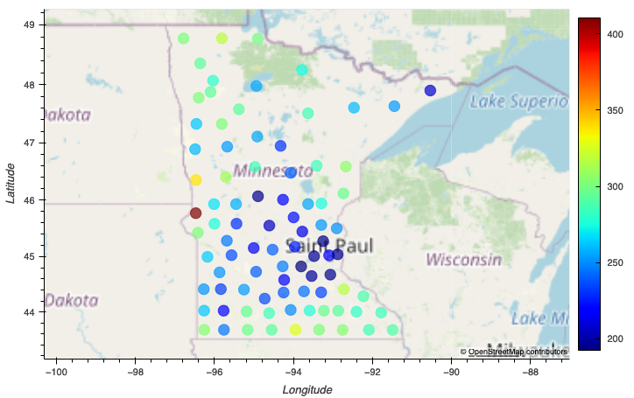
Breakdown of Counties in MN
Blue indicates lower death rates of CVD and red indicates higher. The lower rates are mostly centered around the twin cities metro.
Data Analytics & Data visualization boot camp – University of Minnesota ,Minnesota,USA

Slide 9
The Geographic Summary
Through this analysis, we were able to answer the two questions we were looking for within the above graphs.
Where did MN fall for death rates from CVD among the country.
-Fell is the top 5 lowest among all states.
What part of MN had the highest rates of death from CV disease.
-Western side of MN is where the top 2 areas from cvd death occurred.
Data Analytics & Data visualization boot camp – University of Minnesota ,Minnesota,USA

Slide 10
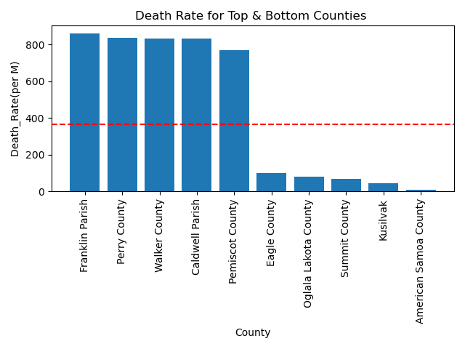
Geographical distribution of CVD death rates
Data Analytics & Data visualization boot camp – University of Minnesota ,Minnesota,USA

Slide 11
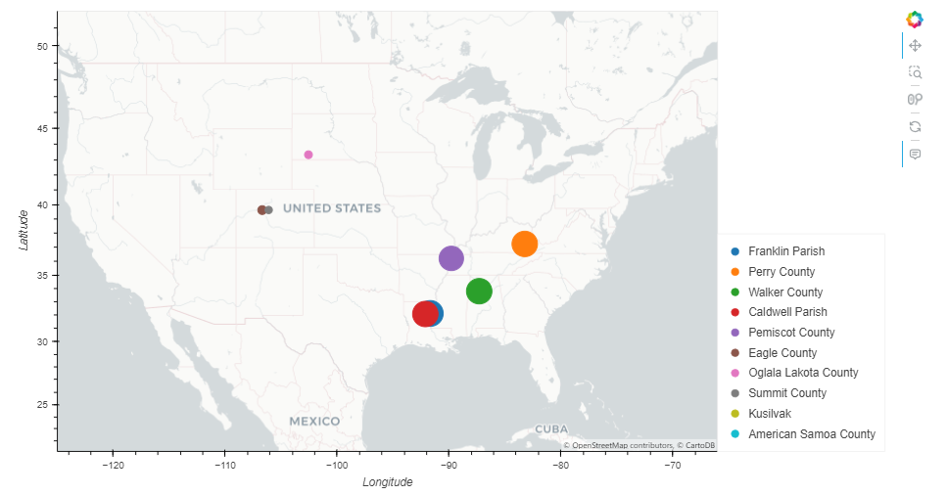
Geographical distribution of CVD death rates
Geographic area of the top and bottom five
Data Analytics & Data visualization boot camp – University of Minnesota ,Minnesota,USA

Slide 12
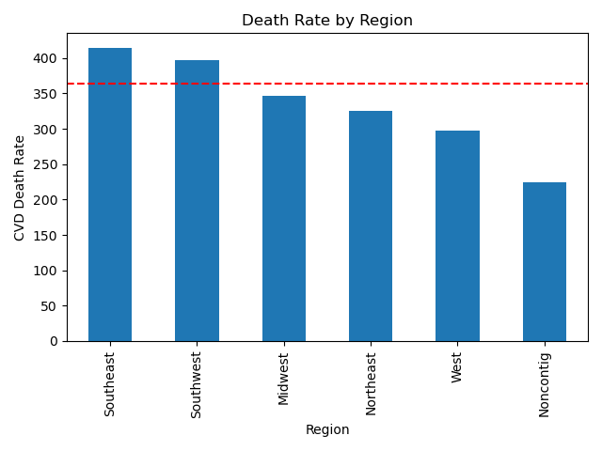
Data Analytics & Data visualization boot camp – University of Minnesota ,Minnesota,USA

Slide 13
Summary of the Geographical analysis of the CVD death rate
When check the top and bottom values of the CVD death rate for all the counties, it can be seen that there are some counties which rates far higher (almost double than the country average) than the country average and some are far below the country average.
When plot these data in a map visual , higher CVD death rates counties are in most southeast region and low rates counties are middle of the country.
Higher CVD death rates can be seen in the south regions of the country having average CVD death rate above the country average.
Data Analytics & Data visualization boot camp – University of Minnesota ,Minnesota,USA

Slide 14
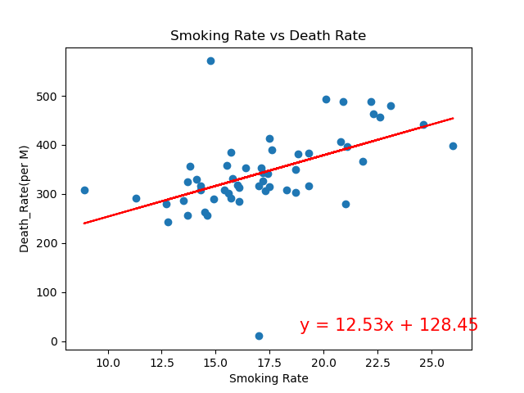
Correlation between CVD death rate and the smoking rate.
In this analysis correlation coefficient (r) values between smoking rate and the CVD death rate is + 0.59.
This means there is a positive relationship between smoking rate and the CVD death rate.
But, when you see the r-squared value, it is 0.3475 and means only 34% chance of changing the CVD death rate by changing the smoking rate.
Data Analytics & Data visualization boot camp – University of Minnesota ,Minnesota,USA

Slide 15
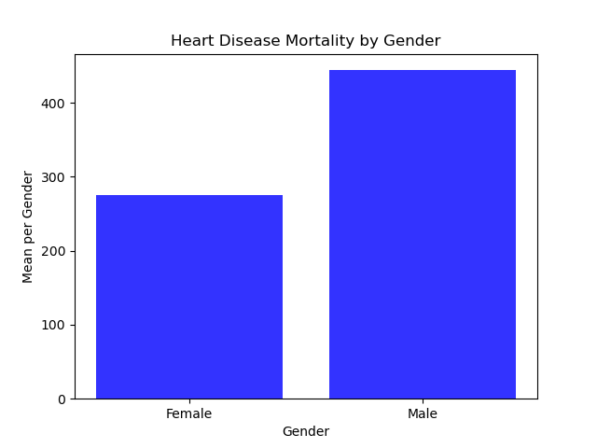
Data Analytics & Data visualization boot camp – University of Minnesota ,Minnesota,USA

Slide 16
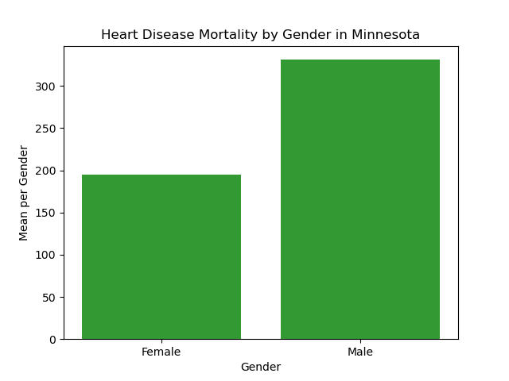
Data Analytics & Data visualization boot camp – University of Minnesota ,Minnesota,USA

Slide 17
Summary of Gender and CVD
Through this analysis, we were able to answer the following questions:
Is CVD mortality rate impacted by gender?
There is a notable increase in CVD mortality for men in the USA
How does Minnesota compare?
Minnesota follows the above trend of increased CVD mortality in males.
Is this impact statistically significant?
There is a statistically significant correlation between gender and CVD mortality.
Data Analytics & Data visualization boot camp – University of Minnesota ,Minnesota,USA
Notes:
-The chi square value of +52000 exceeds the critical value of 3.84, we conclude that the results are statistically significant.

Slide 18
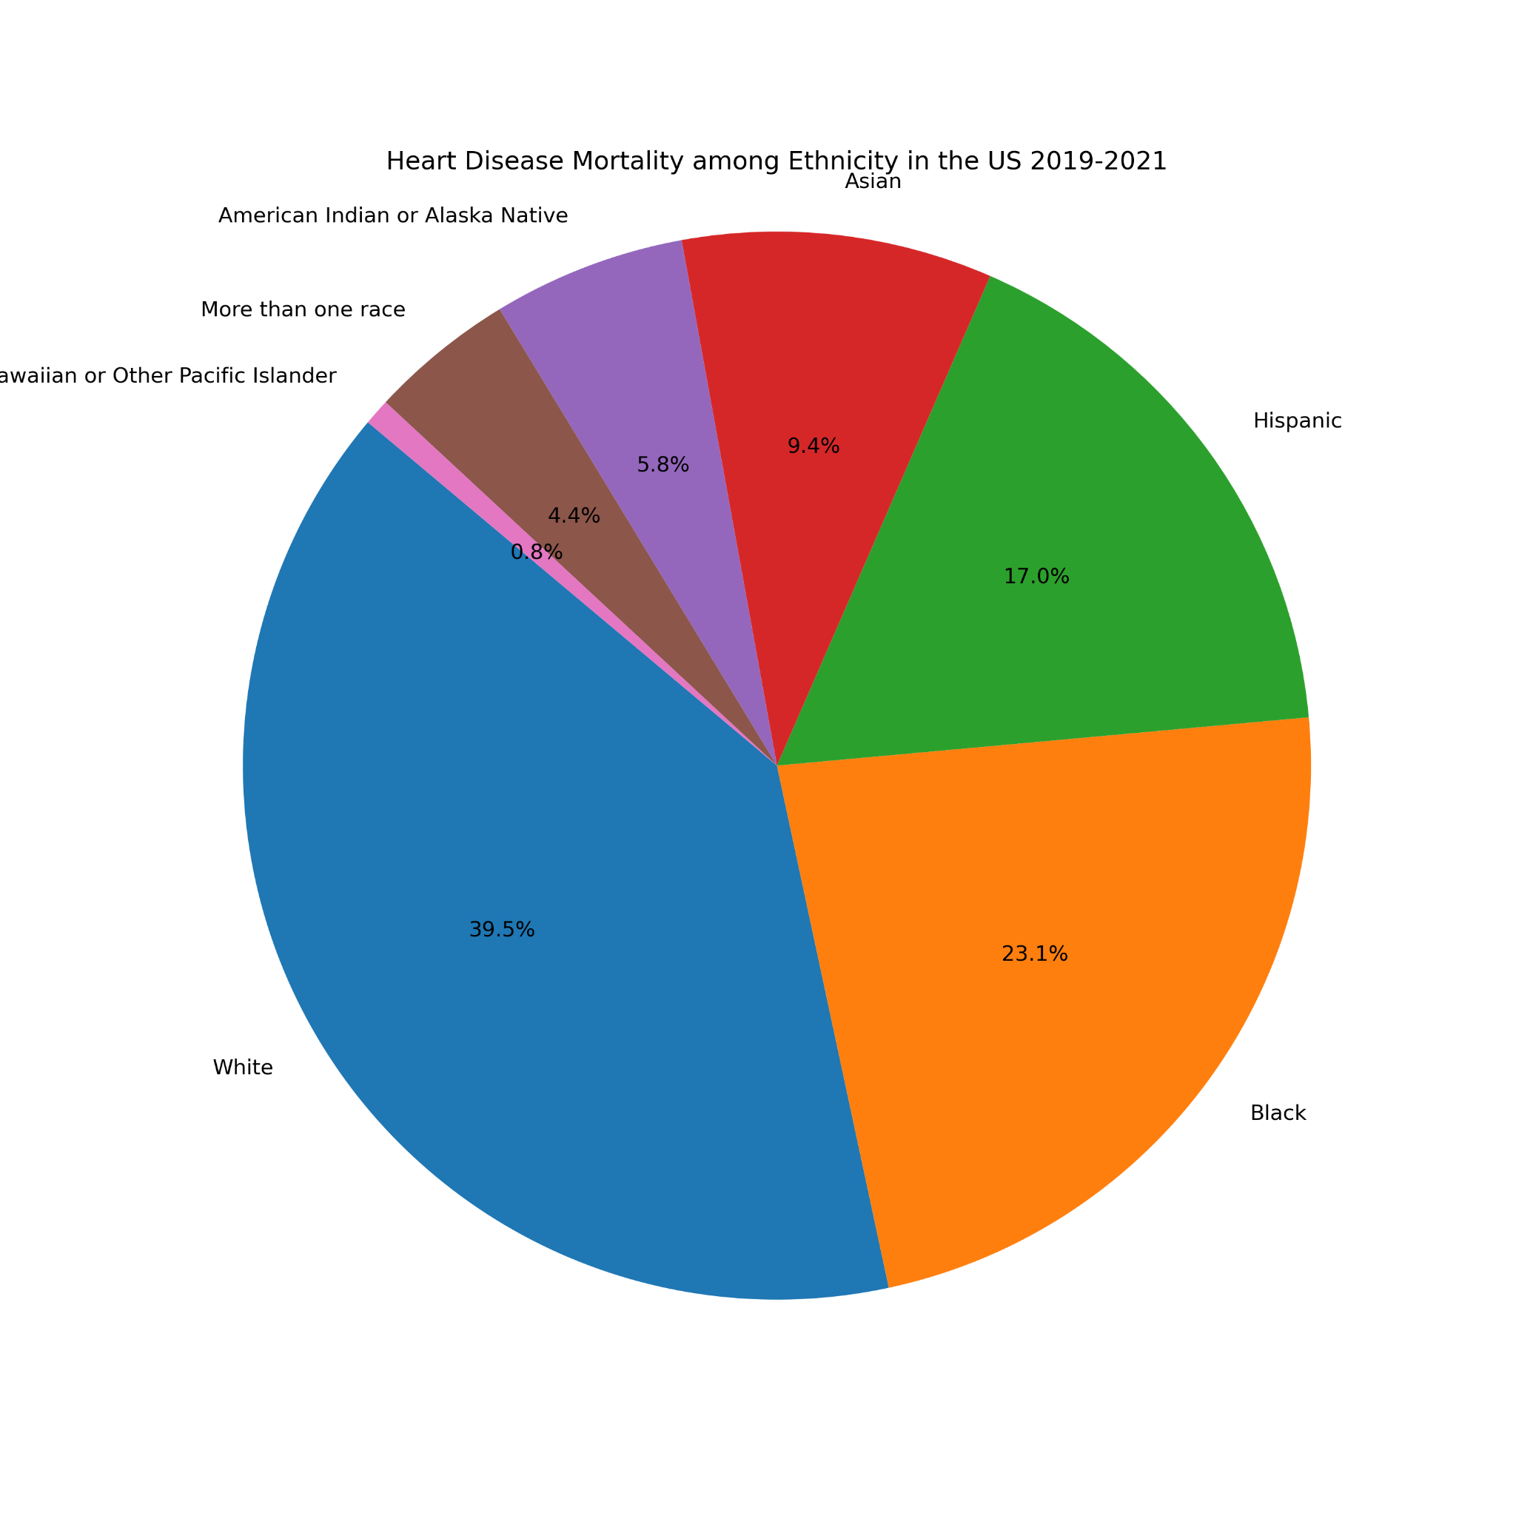

Slide 19
Cardiovascular Disease among Ethnicity
The prevalence of CVD among different ethnic groups is crucial for raising awareness of health inequalities and advocating interventions and targeted resources to communities at higher risk.
This data indicates which ethnic group was reported more often with Cardiovascular diseases.
Data Analytics & Data visualization boot camp – University of Minnesota ,Minnesota,USA

Slide 20
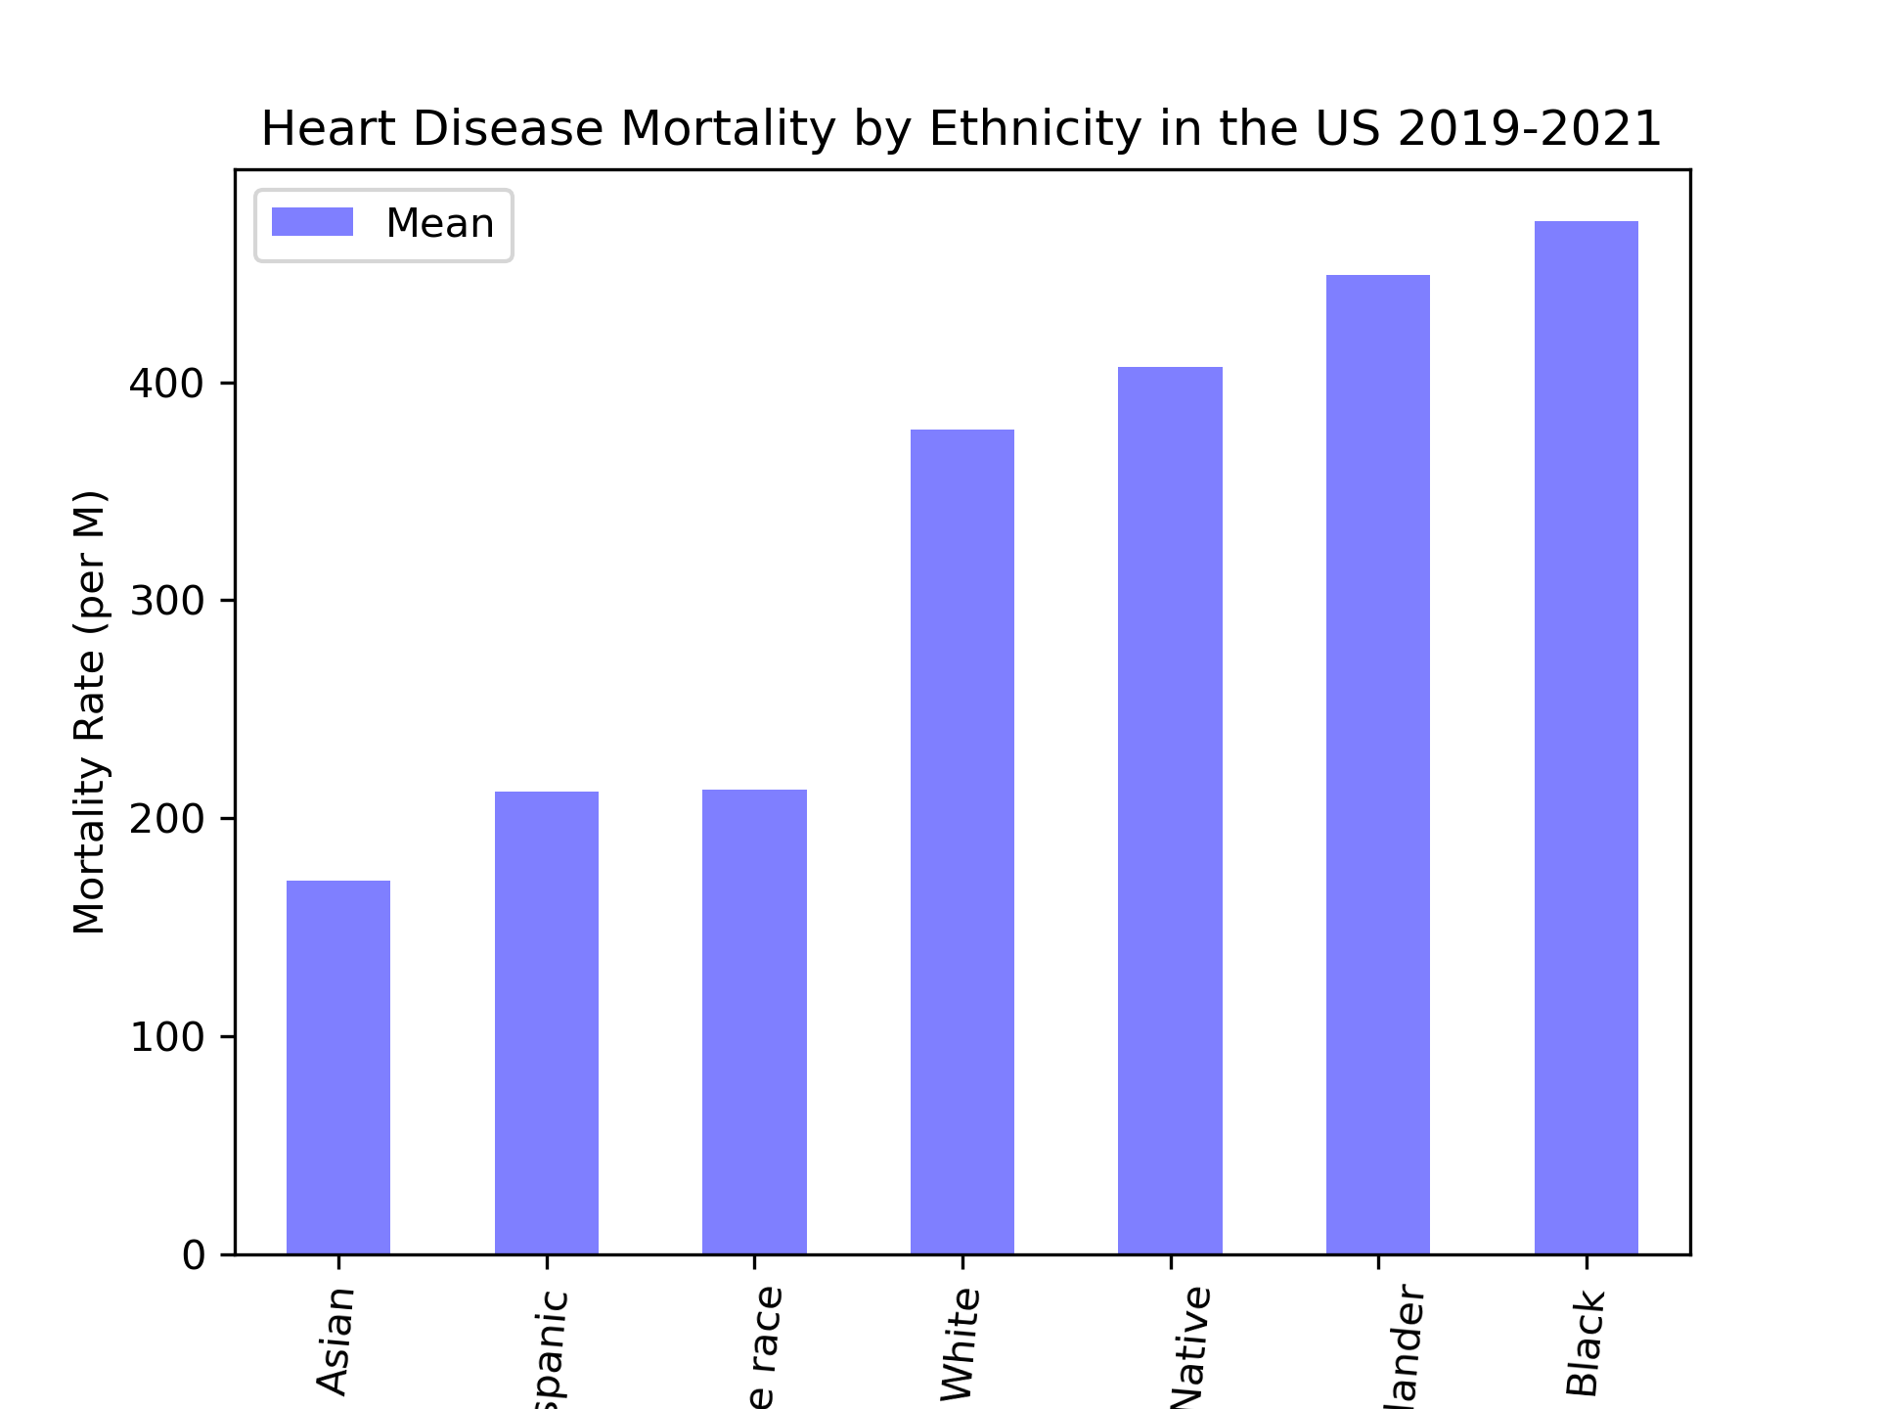
Cardiovascular Disease among Ethnicity
Observation Mortality Rate average by ethnicity
Black have an higher mortality rate than other ethnic groups.
American Indian/Alaskan Native and Hawaiian/other Pacific Islander were also on average higher mortality rate
Hispanic and more than one race are on par with each other mortality rate.
Asian has a lower mortality rate.

Slide 21
Summary of Ethnicity and CVD
Through this analysis, we were able to answer the following questions:
Which ethnicity has the highest reported death rate?
White
Which ethnicity had the highest CVD death rate on average?
Black/African American
Data Analytics & Data visualization boot camp – University of Minnesota ,Minnesota,USA
Notes:
-The chi square value of +52000 exceeds the critical value of 3.84, we conclude that the results are statistically significant.

Slide 22
Conclusion
From our analysis, the data shows that the location, sex, and ethnicity can all be factors that contribute to CVD death rates.
Cardiovascular Disease is more prevalent in:
Southeastern states
Males than females
Black/African Americans than other ethnicities.
Data Analytics & Data visualization boot camp – University of Minnesota ,Minnesota,USA

Slide 23
Q & A
Data Analytics & Data visualization boot camp – University of Minnesota ,Minnesota,USA

Slide 24
Thank you
Git Project repository
https://github.com/leeju09/Project-1-Heart-Disease.git
Data Analytics & Data visualization boot camp – University of Minnesota ,Minnesota,USA

